Slide 1
Information Retrieval Project
Group 8
Group members:
Jared Nathaniel Chan Weng Wai (U2022954B)
Liau Zheng Wei (U2222032K)
Toh Yong Li (U2021290D)
Beh Ming Jun (U2022747E)
Ooi Yi Hang (U2022327K)
Wentai Nan (U2022249B)
Notes:
Hi, we are group 8

Slide 2
Group Member Roles
Name | Contribution
Jared Nathaniel Chan Weng Wai | Classification and Report write up
Liau Zheng Wei | Classification and Indexing
Toh Yong Li | Web Crawling and UI development
Beh Ming Jun | Classification and Report write up
Ooi Yi Hang | Classification and Video
Wentai Nan | Classification and Slides
Notes:
And our group members are Zheng Wei, Jared, Yong Li, Yi Hang, Wen Tai and Ming Jun. These are the roles of each group member.

Slide 3
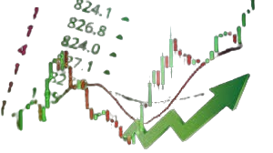
Tech Stocks
Query System
Large amounts of data on stock news
Difficult for investors to obtain relevant and up to date information
Aims to provide a sentiment analysis on top tech stocks
Notes:
Our project is a search engine based on a stock sentiment prediction model that allows users to obtain detailed sentiment analysis of specific stocks. We chose this topic due to the sheer volume of financial news making it challenging for investors to gauge market sentiment towards different stocks.

Slide 4

Crawling
Web scraping methods
Crawled data
Notes:
Next, we will discuss our web scraping methods.

Slide 5





Crawling Methods
Notes:
To scrap the news articles from Yahoo News, we utilised various Python libraries, such as, requests was used to make HTTP requests, Beautiful Soup to parse HTML, and csv for data storage.

Slide 6
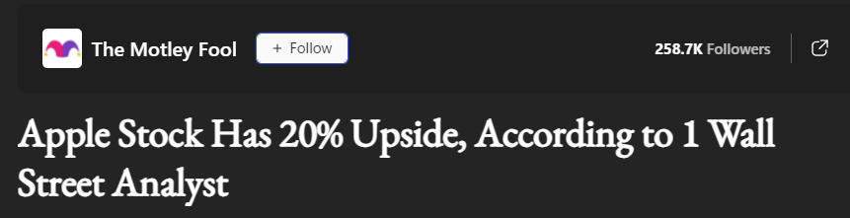
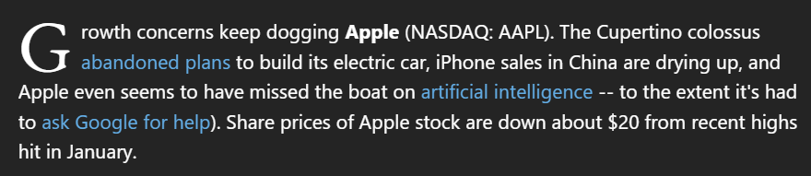
Crawled Data
Headline
Source
Posted Date
Description
Link
20/04/23
Notes:
We decided to scrape the headline, source, date posted, URL link of new articles as well as a brief description of the first paragraph of each article.

Slide 7





Crawled Data
Number of Records | Number of Words
10,916 | 484,908
Notes:
We focused on 5 stocks, namely, Amazon, Google, Nvidia, Apple and Microsoft. The number of records and words obtained are shown in this table.

Slide 8
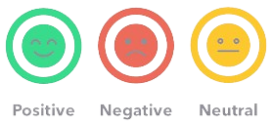
Classification
Data preprocessing
Model training
Enhancements
Results
Notes:
Next, we will discuss our classification methods.

Slide 9
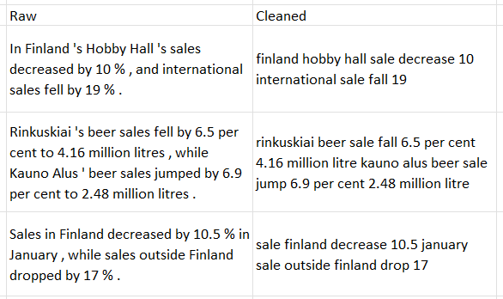
Data Cleaning
Raw
Cleaned
tokenisation
remove stopwords punctuations and special characters
lower case
stemming and lemmatisation
Notes:
We preprocessed the data by removing stopwords, special characters, punctuations followed by stemming and lemmatization, ensuring that different variations of the same word are grouped together.

Slide 10
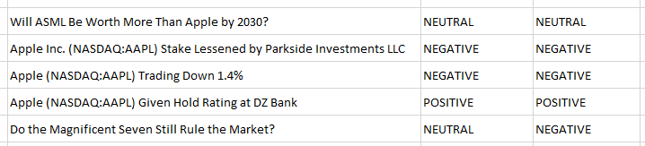
Data Labelling
Headline
Annotator 1
Annotator 2
Fleiss’ Kappa score : 96.6%
Notes:
When manually labelling our scraped data, we obtained an inter-annotator agreement score of 96% between 2 annotators using Fleiss’ Kappa formula.

Slide 11
Model Training
Reference Model
Feature Extraction
Classification Models
Naive Bayes
SVM
Logistic Regression
Random Forest
KNN
SGD
Cognitive Models
Liquid Time Constant
Spiking CNN
SOTA Model
TF-IDF with SVM
TF-IDF
N-Grams
BERT Word Embeddings
GloVe
Notes:
To train our model, we referred to the SOTA model for sentiment classification on the 20NEWS dataset which is TF-IDF with SVM. Pre-trained language models that lead the field were excluded due to potential look-ahead bias. However, using their embeddings avoids this issue as they are designed to be temporally neutral, by capturing a wide range of contexts and are not limited to specific events, regardless of the sentiment of the articles.
We explored several text feature extraction techniques; TF-IDF, N-grams, BERT word embeddings, and GloVe. These were combined with various ML models, such as SVM, Naive Bayes, Logistic Regression, Random Forest, KNN, and various cognitive neural network architectures.

Slide 12
Classification Results
Subjectivity
Model |  | Accuracy | F1 | Precision | Recall
Count Vectoriser Unigrams | Naive Bayes | 0.55 | 0.53 | 0.55 | 0.56
TF-IDF Unigrams | SVM | 0.56 | 0.54 | 0.58 | 0.59
TF-IDF Unigrams + BERT word embeddings | Logistic Regression | 0.58 | 0.57 | 0.60 | 0.62
Notes:
These are some of our classification results based on macro average for subjectivity.

Slide 13
Classification Results
Polarity
Model |  | Accuracy | F1 | Precision | Recall
Count Vectoriser Unigrams | Naive Bayes | 0.70 | 0.70 | 0.71 | 0.70
TF-IDF Unigrams | SVM | 0.73 | 0.72 | 0.73 | 0.72
TF-IDF Unigrams + BERT word embeddings | Logistic Regression | 0.79 | 0.78 | 0.79 | 0.79
TF-IDF Unigrams, Bigrams and Trigrams + BERT word embeddings | Logistic Regression | 0.78 | 0.78 | 0.78 | 0.78
Notes:
These are some of our classification results based on macro average for polarity.

Slide 14
Model Enhancements
Ensemble
Hard Voting
RF & LR
Soft Voting
RF & LR
Stacking
RF & SVM
SOTA
72%
73%
74%
75%
Notes:
To enhance the SOTA model, we performed ensemble classification. Using the voting method of Random Forest and Logistic Regression, the accuracy increased to 74% and 73% for soft and hard voting respectively. When using Stacking on Random Forest and SVM, the accuracy increased to 75%.

Slide 15
Final Model
Model |  | Accuracy | F1 | Precision | Recall
TF-IDF Unigrams + BERT word embeddings | Logistic Regression | 0.79 | 0.78 | 0.79 | 0.79
with Ensemble Voting | Random Forest | 0.58 | 0.50 | 0.72 | 0.58
with Ensemble Stacking | Random Forest and Logistic Regression | 0.78 | 0.78 | 0.78 | 0.78
Random Accuracy
random chance to assign sentiment
model performs better
Scalability
matrix operations for linear computations
parallelized and optimised for larger data
Notes:
Based on the classification results, we decided to use the TF-IDF + BERT word embeddings model as it performed better than the SOTA model.
When trying the ensemble voting method of Random Forest and ensemble stacking method of Random Forest and Logistic Regression on this selected model, we saw accuracy decrease to 58% and 77% respectively.
A random accuracy test was performed by getting a random row and its Sentiment which is compared to a randomly chosen sentiment. By determining sentiment of the text, we can show that the model is better than random chance.
As we used logistic regression for our model, we can efficiently perform the linear computations using matrix operations that can be parallelized and optimised for high performance when the dataset is large, implying scalability.

Slide 16

Indexing
Data indexing
Query
Notes:
Next, we will discuss our indexing methods.

Slide 17

Data Indexing
CSV row read as dictionary
map dict keys to Solr schema field
Solr documents added to index
Notes:
Having labelled all our scraped data, we then used pysolr to index and query our labelled data in Solr.

Slide 18
Query
Query Field
User Preference
Query Input
4
Choose a Data Field
(Optional) Filter Start and End date
(Optional) Sort date by asc or desc
Enter query
Eg. Headline, “apple”, 2024-02-16 to 2024-03-31, asc
String:
'Headline:"apple" AND Posted:["2024-02-16T00:00:00Z" TO "2024-03-31T23:59:59Z"]'
Parameter: **{'start': 0, 'rows': 20000, 'sort':'Posted ' + asc}
Data Field: Headline, Source, Posted, Description, Link
Query from pre-specified start and end (or max) index
1
2
4
3
Notes:
During querying, users have the flexibility to tailor their input according to the data field they're interested in. They can specify the date range and choose whether the results should be sorted in ascending or descending order based on the dates. These user inputs are subsequently converted into strings to seamlessly integrate into the search process.

Slide 19

Demo

Slide 20
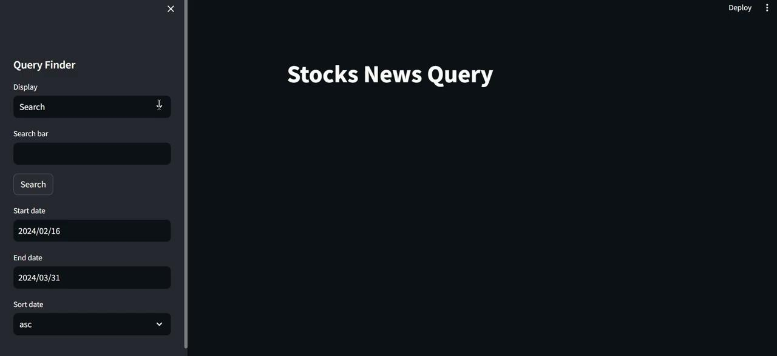
Overview

Slide 21
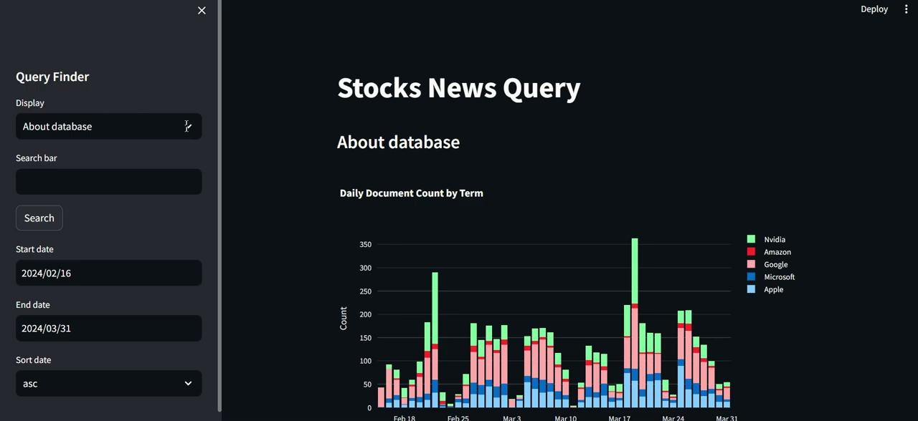
‘About Database’ Display

Slide 22
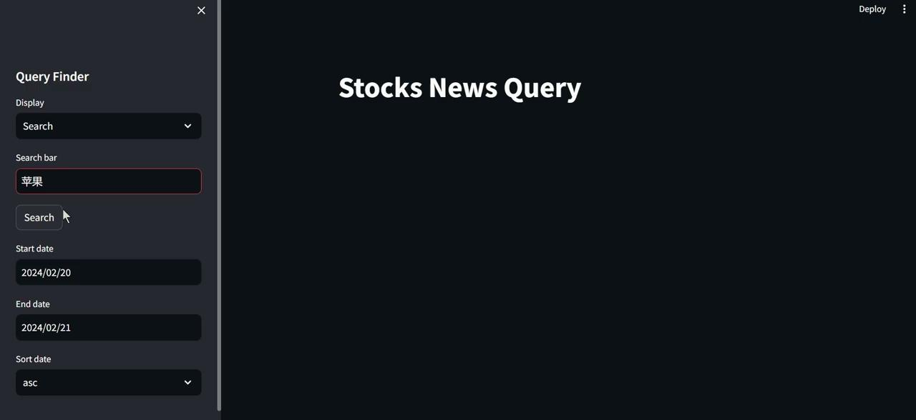
Multilingual Search

Slide 23
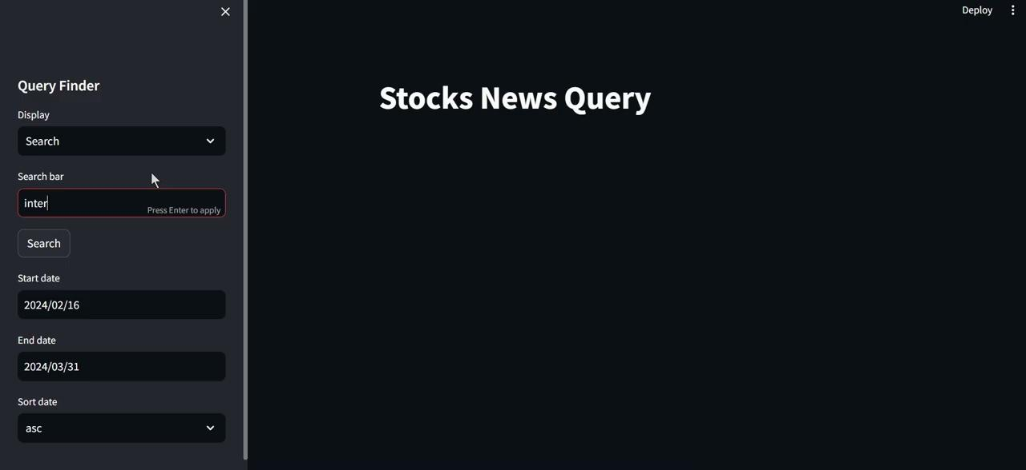
Query Suggestion

Slide 24
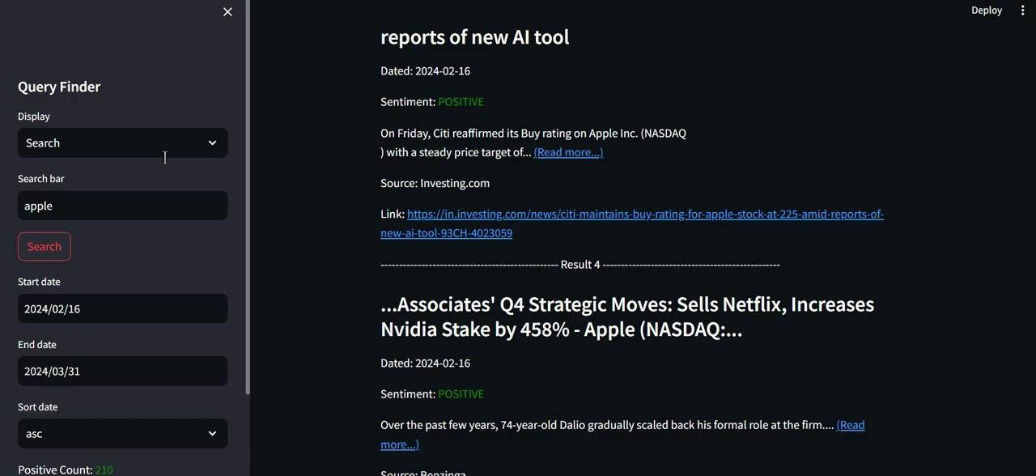
Sentimental Count Display

Slide 25
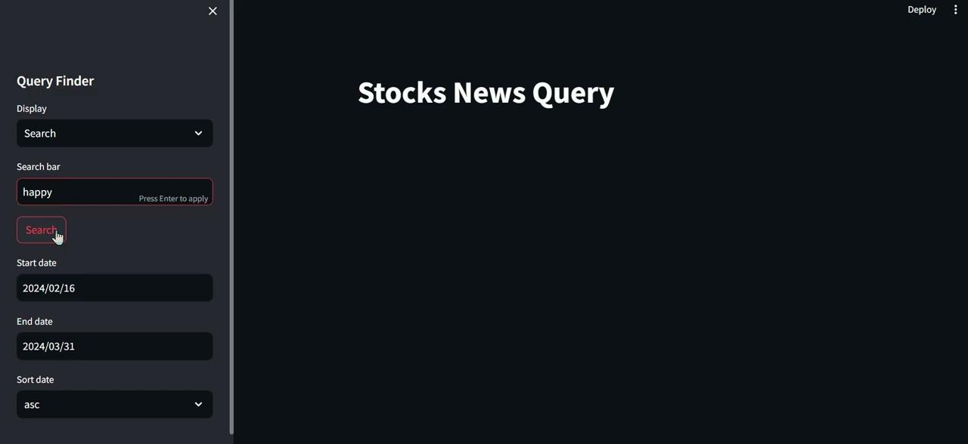
Further Query Suggestions (Synonym and Antonym)

Slide 26





~ The End ~

